Slide 1

Our Actions in My Mind: Motor Imagery of Joint Action
Cordula Vesper, Natalie Sebanz, & Günther Knoblich

Slide 2
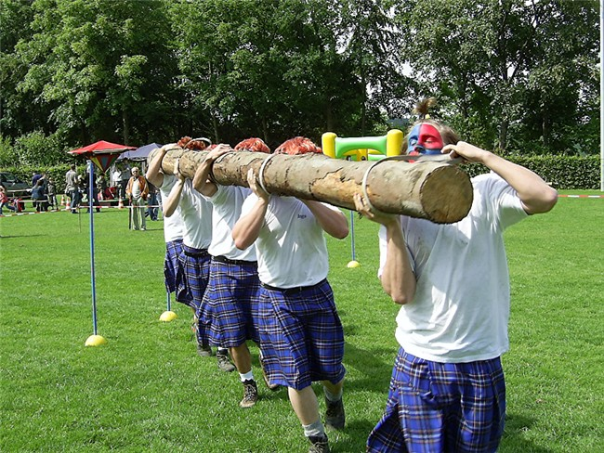
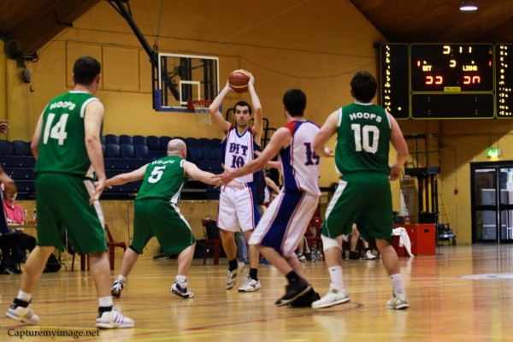
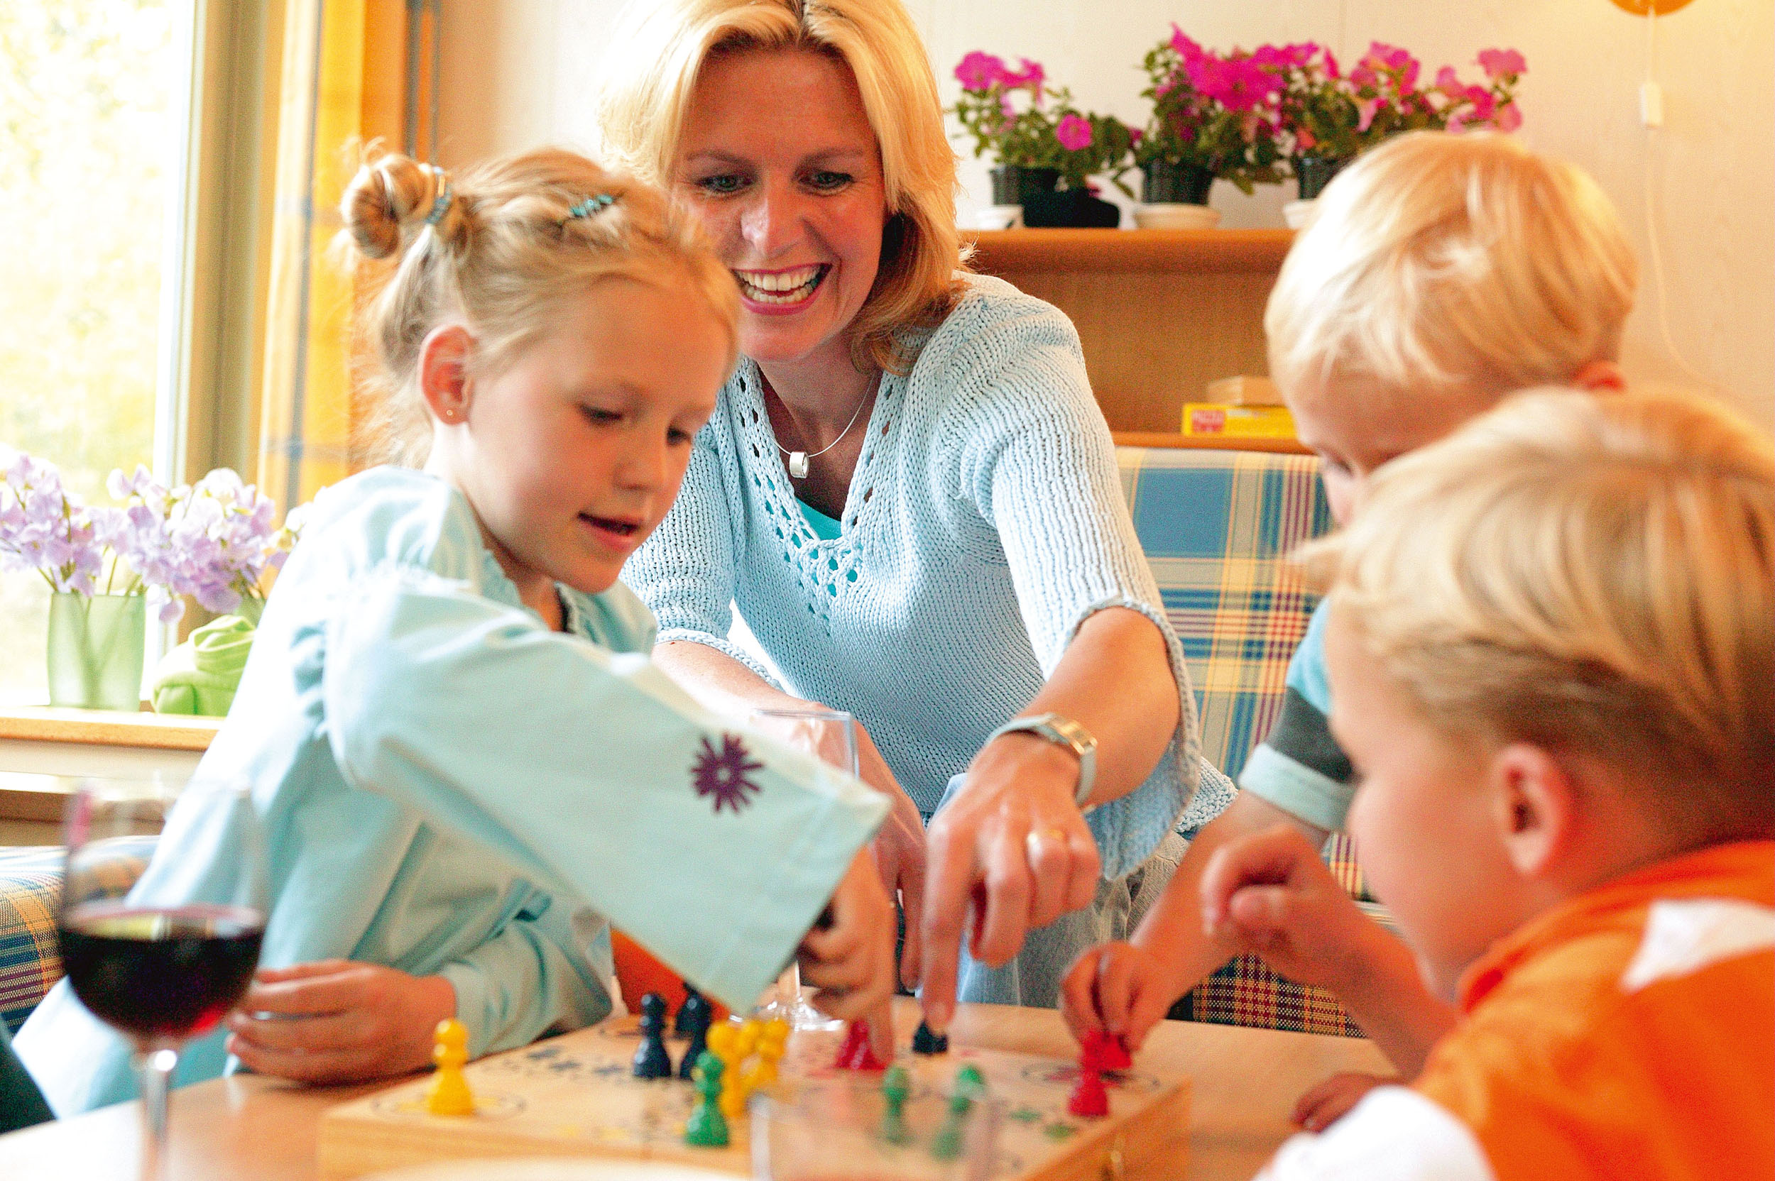
Joint Action

Slide 3
Imagery of Joint Action?

Slide 4
Action Simulation
Why is this interesting?
SELF
execution
actual sensorimotor outcome
simulation
predicted sensorimotor outcome

Slide 5
Action Simulation
Why is this interesting?
SELF
simulation
predicted sensorimotor outcome

Slide 6
Action Simulation
Why is this interesting?
SELF
execution
actual sensorimotor outcome
simulation
predicted sensorimotor outcome
OTHER
observation
actual perceptual outcome
simulation
predicted perceptual outcome

Slide 7
Action Simulation
Why is this interesting?
SELF
simulation
predicted sensorimotor outcome
OTHER
simulation
predicted perceptual outcome

Slide 8
Action Simulation
Why is this interesting?
Imagery, as a “pure” form of action simulation, allows to directly investigate the integration of action simulation for one’s own and another person’s actions to achieve coordination.
Hypotheses
Individuals can imagine acting together with others.
Principles of joint action performance hold in joint action imagery.
Imagery of joint action is motor imagery.

Slide 9
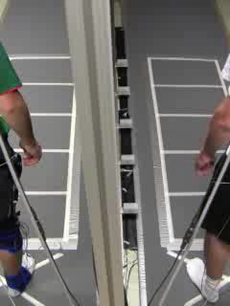
Joint Action Performance
Joint jumping task (performance): „Land at the same time!“
140 cm
140 cm
105 cm
105 cm
70 cm
70 cm
35 cm
35 cm
Vesper et al., 2012, JEP-HPP

Slide 10
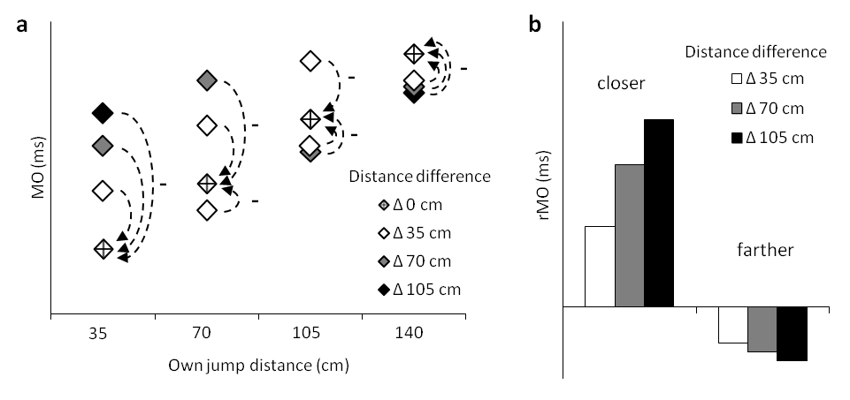
Joint Action Performance
Joint jumping task (performance): „Land at the same time!“
Relative jump duration (ms)
140 cm
140 cm
105 cm
105 cm
70 cm
70 cm
35 cm
35 cm
Vesper et al., 2012, JEP-HPP

Slide 11
Joint Action Performance
Adaptation of jump duration: scaled to difference in jump distance
Role distribution: only closer person adapts
Specific for coordination: no modulation in individual
VESPER ET AL., 2012: PERFORMANCE
Distance difference
*
closer
farther
individual
joint
individual
joint

Slide 12
Joint Action Imagery: Experiment 1
Joint jumping imagery
Task: “Imagine to jump while landing at the same time as another person on the other side of the occluder!”
Measurement: Self-reported duration of imagined jump
Experiment 1: Does imagery of joint action resemble performance?

Slide 13
Joint Action Imagery: Experiment 1
Adaptation of jump duration: scaled to difference in jump distance
Role distribution: only closer person adapts
Specific for coordination: no modulation in individual
EXPERIMENT 1: IMAGERY
Distance difference
*
closer
farther
individual
joint
individual
joint

Slide 14
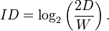
Joint Action Imagery: Experiment 1
Yes.
Experiment 1: Does imagery of joint action resemble performance?
Experiment 2: Does imagery of joint action reflect a violation of Fitts’ law?
Fitts’ law:
Movement times predicted not by distance or target width alone, but by index of difficulty (ID) (Fitts, 1954)
But: Violation of Fitts’ law in individual jumping (Juras et al., 2009)

Slide 15
Joint Action Imagery: Experiment 2
Same pattern of adaptation as in Experiment 1
EXPERIMENT 2: DISTANCE
Distance difference
*
closer
farther
individual
joint
individual
joint

Slide 16
Joint Action Imagery: Experiment 2
EXPERIMENT 2: INDEX OF DIFFICULTY
ID not reflected in imagery of joint action: violation of Fitts’ law!
ID difference
closer
farther
individual
joint
individual
joint

Slide 17
Joint Action Imagery: Experiment 2
Yes.
Experiment 1: Does imagery of joint action resemble performance?
Experiment 2: Does imagery of joint action reflect a violation of Fitts’ law?
Hypotheses
Individuals can imagine acting together with others.
Principles of joint action performance hold in joint action imagery.
Imagery of joint action is motor imagery.
Yes.

Slide 18
Conclusion
Taken together, by utilizing that imagery is a “pure” form of action simulation, this study demonstrates that action simulation for one’s own and another person’s actions can be integrated to achieve coordination.
→ Our actions in my mind!
Thank you.

Slide 20
Notes:
This is not MO, but JT

Slide 21
VESPER ET AL., 2012: PERFORMANCE
Distance difference
*
closer
farther
individual
joint
individual
joint
Notes:
Take left graph out everywhere (put in the back of the presentation)

Slide 22
EXPERIMENT 1: IMAGERY
Distance difference
*
closer
farther
individual
joint
individual
joint

Slide 23
EXPEIRMENT 2: DISTANCE
Distance difference
*
closer
farther
individual
joint
individual
joint

Slide 24
EXPERIMENT 2: INDEX OF DIFFICULTY
ID difference
closer
farther
individual
joint
individual
joint

Slide 25
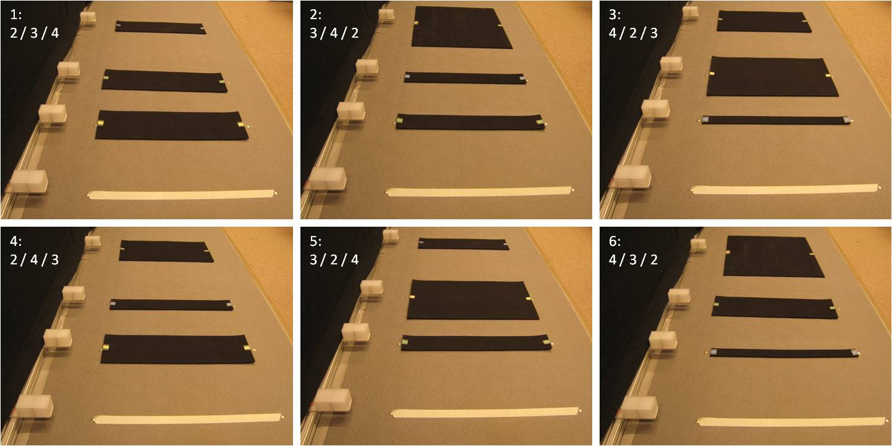
Imagery task manipulating both distance and index of difficulty (ID)
D
 | 28 | 56 | 140
3.5 | 4
7 | 3 | 4
14 | 2 | 3 | 4
28 |  | 2 | 3
56 |  |  | 2
W

Slide 26
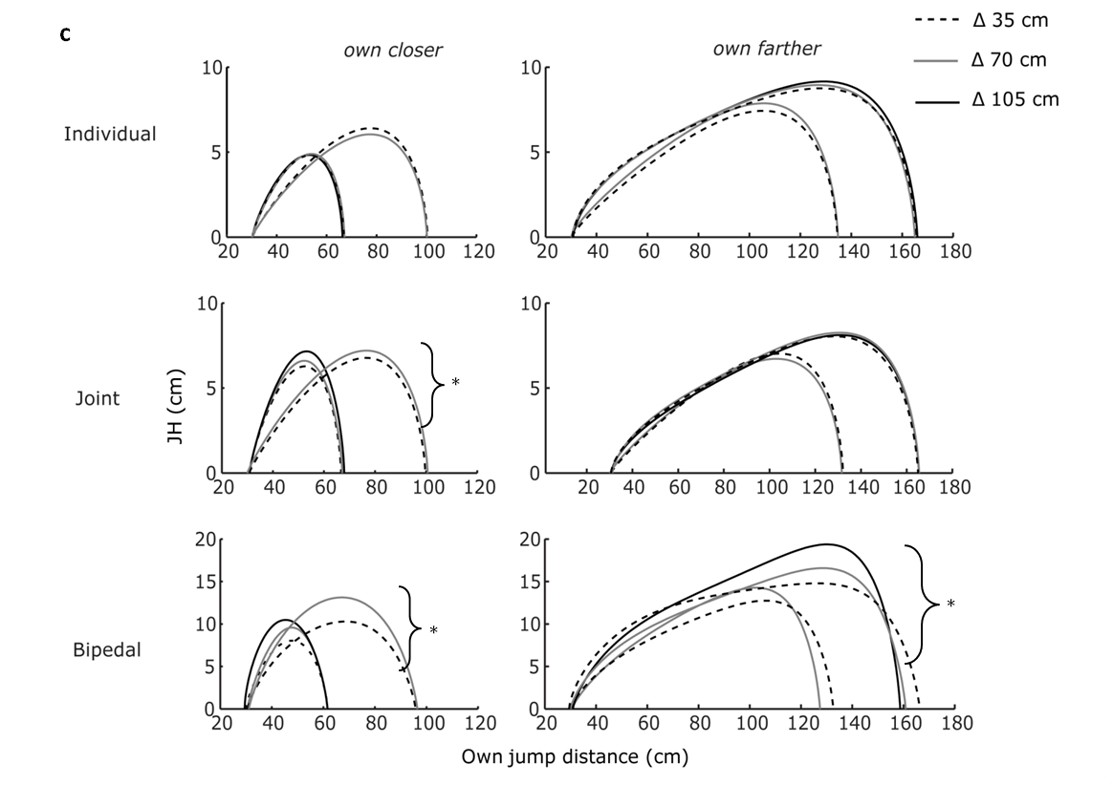

Slide 27
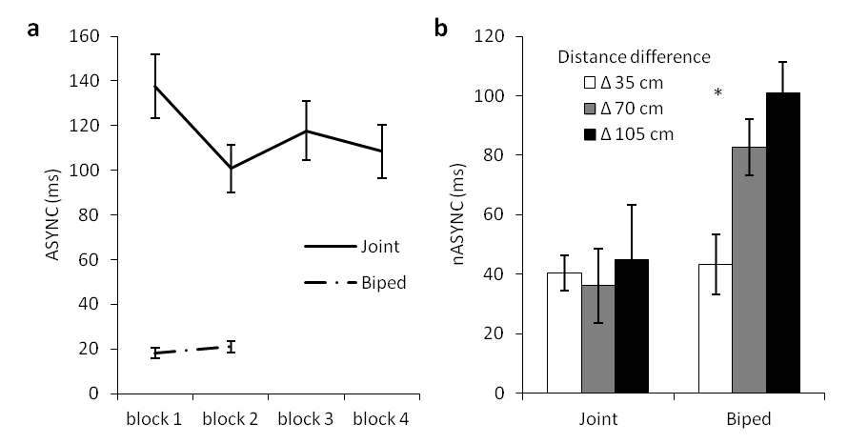
Results: Coordination performance

